Slide 1
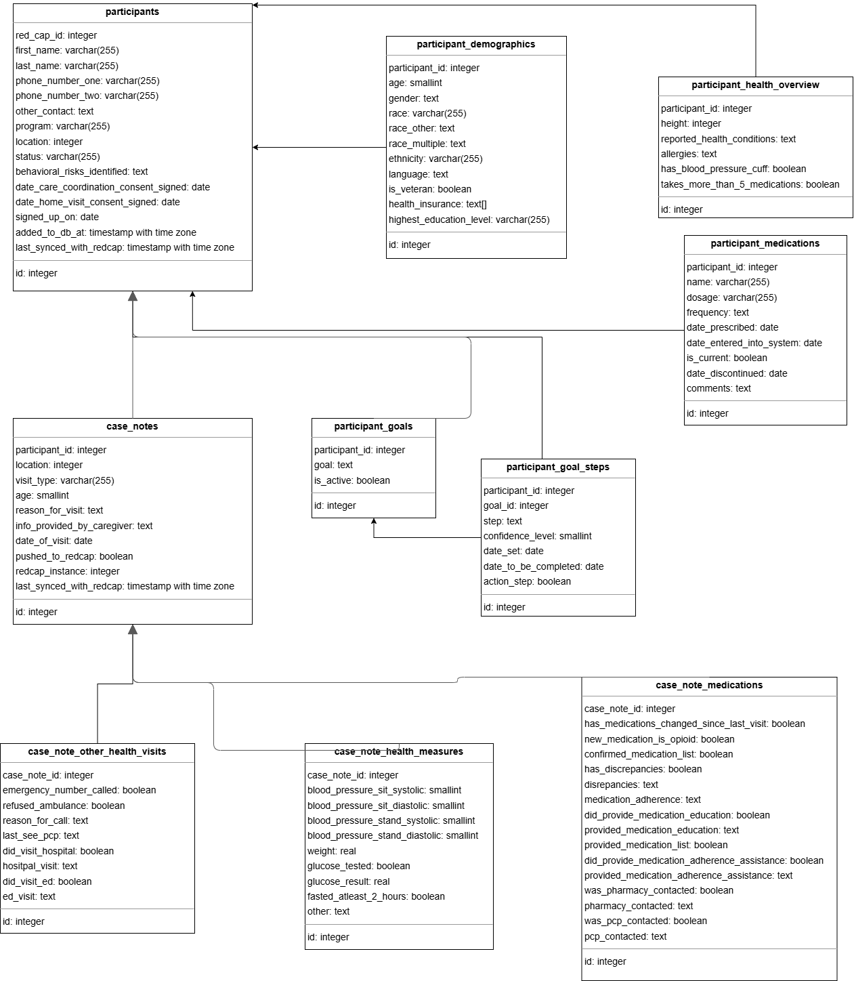
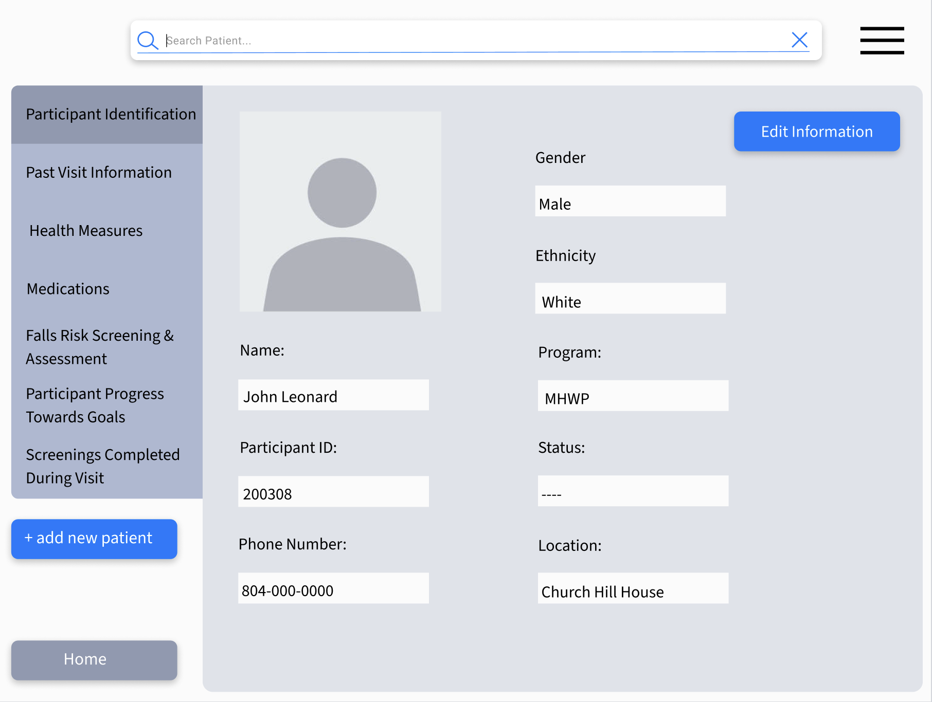
25-303
Tablet-based Application For Clinicians
Team members: Tyree Carpenter, Shikriti Ghosh, Ebenezer Hailu, and Wyatt Herkamp | Faculty adviser: John Leonard Ph.D. | Sponsor: VCU School of Nursing | Mentor: Jered Wendte
Problem Statement
Design and Technical Progress
Prototype and Future Work
Design, implement, and document a prototype for a tablet-based application that can be used by clinicians prior to their meeting with patients that can summarize past survey responses and better prepare the clinician for their meeting with the patient.
Expanding the Goals
After visiting the MHWP site, we observed that our project only partially addresses the clinicians' challenges. While our app would help clinicians prepare for meetings with patients more efficiently, it currently requires them to switch back to their outdated system to enter new data, which our app would read in future sessions. A more effective solution would be to enable clinicians to both prepare for meetings and directly input new data into our app, seamlessly integrating with their existing records. This approach would offer significant benefits to the clinicians.
Though our prototype is not fully built at current, we have a foundation to work with using the legacy REDCap system. The REDCap system is outdated & oftentimes makes it more difficult for the clinicians as they are editing patient data. Our solution aims to make this a more efficient process, modeling after the already existing system, while making it more tailored to the clinicians needs & looking more modern at the same time. The ways that we plan on improving are generally enhancing user experience by placing the most pertinent information for the clinicians in easy to access parts of the page that are readily available. As well adding the capability to add new case notes in the same places that allow for the clinician to see existing ones. There are numerous examples where adding dropdown menus could be beneficial instead of laborious scrolling, as well as where the dimensions of certain text fields become pain points for the users. These are all things that we want to address in our prototypes.
Expected Impact
This database design is based on the previously existing database that is being utilized by the MHWP currently, with changes to ensure for interoperability & future scalability as well. We have made some changes that allow for more consistent data, while at the same time entirely mapping to the forms that the clinicians are already accustomed to interacting with. Also, by making a full mapping of the data that already exists in the database, it has allowed us to broaden the scope of our project to allow for editing of patient data in real time. This would be helpful because at the same time as they read the data about the patient, if they realize that some information is outdated, they could edit it as well while being consistent with historical data.
The expected impact of this project is to enhance the efficiency and quality of care within the MHWP by ensuring clinicians have quick and reliable access to accurate participant information. This will reduce the risk of lost data, minimize delays, and improve continuity of care, even with rotating clinicians. Ultimately, the solution will lead to better participant outcomes, streamlined clinician workflow, and a more effective mobile healthcare experience.

